Slide 1
KartZed E-Commerce

Slide 2

Introduction
KartZed provide a platform for selling games and services, It can also be used to build brand awareness, provide customer support, and collect valuable data about customer behaviour and preferences.

Slide 3
Existing Systems
The approach of our website is very unique so there is no existing system that provide the same services. Although there is a website called gameflip that so the similar work but has very poor website maintenance. Also, it is taking more time to manage customer services, reporting, and other activities. We have a system in place to record both business and non-business interactions, but it still has certain shortcomings.

Slide 4
Need for the System
The existing system has a number of drawbacks. The shortcomings of the current system are addressed by the suggested system. There are various benefits to the suggested approach that make it possible to do business solely from a window. Complexity and time are not completely eliminated. All transactions relating to business are logged in one location. Work on client feedback and service management becomes increasingly concentrated. With reports produced by an automated system, business analysis and gap discovery are made simple. Large-scale company operations can be managed successfully.

Slide 5
E-commerce websites offer a wide range of products, from local to global, 24/7 access, quick and easy shopping experience, time-saving, lower prices, discounts, coupons, and deals, and rich product information. This also offer multiple payment options, such as credit/debit cards, PayPal, and more, making it convenient for users to pay.
Objectives

Slide 6
Problem Definition
Various challenges and limitations that affect users worldwide. Some of the problems with offline shopping include:
Limited accessibility and availability
Time-consuming
Increased prices
Restricted access to information
Limited payment options

Slide 7
Advantages and Limitations
Advantages:
One stop solution
Simple navigation
Quick product display
Increase in availability
Ease user task by 60-70%
One Stop Solution
Simple Navigation
Quick Product Display
Increase in Availability
Eases User Task by 60-70%
Limitations:
Less contact with service provider
Verification insecurity

Slide 8
Core Components
User Management
Transaction Management
Master Management
Reports
Registration
Login
Product pages
Product Categories
Product Description
Product Availabilities
Search functionalities
Product Filtering
Product Sorting
Quantity Selector
Wishlist
Shopping Cart
Contact Form
Payment Gateway (admin)
Discounts and Promotions
Payment Gateway (user)
Special offers and promotions (user)
Dashboard overview
Inventory Showcase
Product Management
Shipping Management
Customer Reviews & Feedbacks
Review Management
Order Management
Content Management
Inventory Management
Sales analytics and reports (admin)
Reporting and analytics
Analytics and Tracking (merchant)
Order status updates (user)

Slide 9
Targeted Users
1
Customers
2
Venders/Sellers
3
Gamers
4
Professionals
5
Budget Shoppers

Slide 10
Project Profile
Project Title
KartZed
Front-end
Python, HTML5, CSS3, JavaScript
Evaluate By
Dr. Jignesh Doshi (HOD)
Framework
Django
Backend
Python, MongoDB

Slide 11
User Requirements
End User Requirements
Administrator Requirements
Easy Navigation
Product Information
Search Functionality
User-Friendly Checkout
Secure Payment Options
Mobile Responsiveness
Customer Support
Personalization
Different browser supports (including versions)
Wishlist and Shopping carts (future purchase).
Users should be able to view & track the status of items they have ordered.
Administrators should be able to manage eCommerce applications using Web browsers.
Data managers should be able to delete users.
Site administrators should be able to change the status of goods purchased by users after items have been shipped.
Administrators should be able to view all user transactions.
Site managers should be able to view all transactions for the day.

Slide 12
Requirement Determination
User have to search valid information
Vendors have to maintain availability of product
Only verified products must be sold

Slide 13
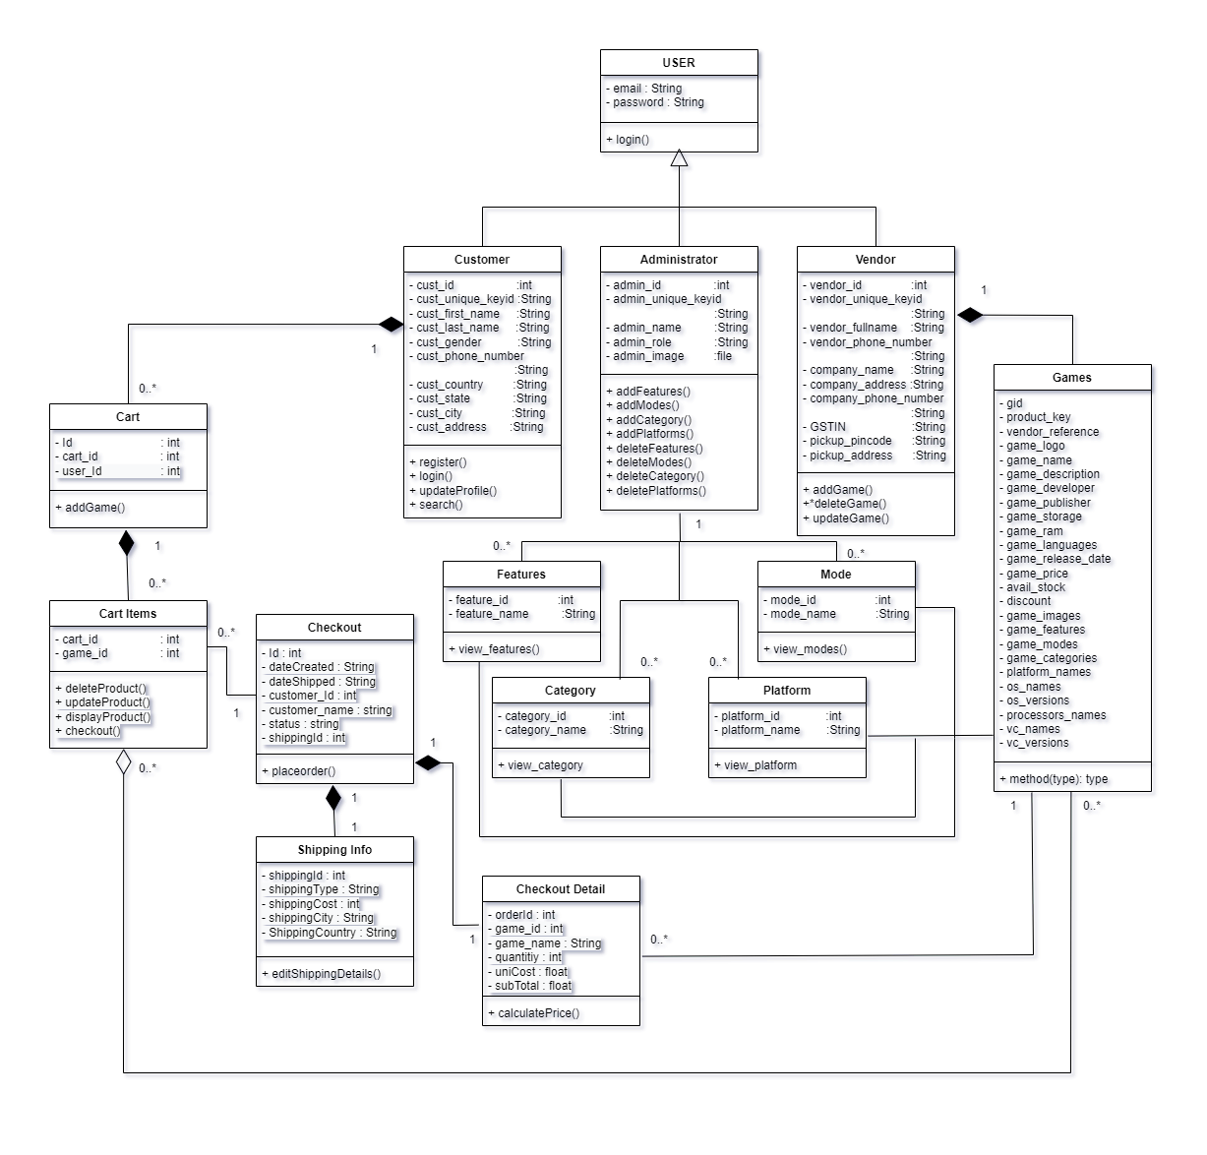
Class Diagram

Slide 14
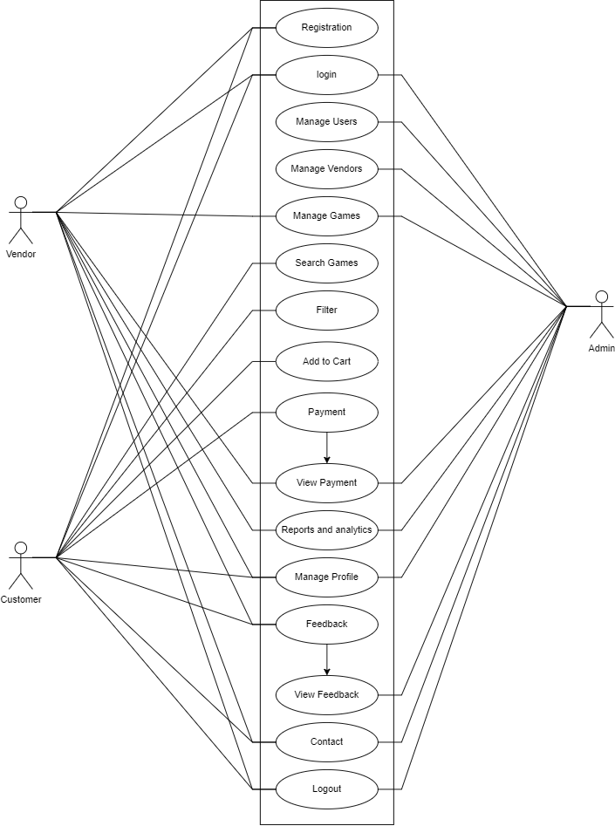
Use Case Diagram

Slide 15
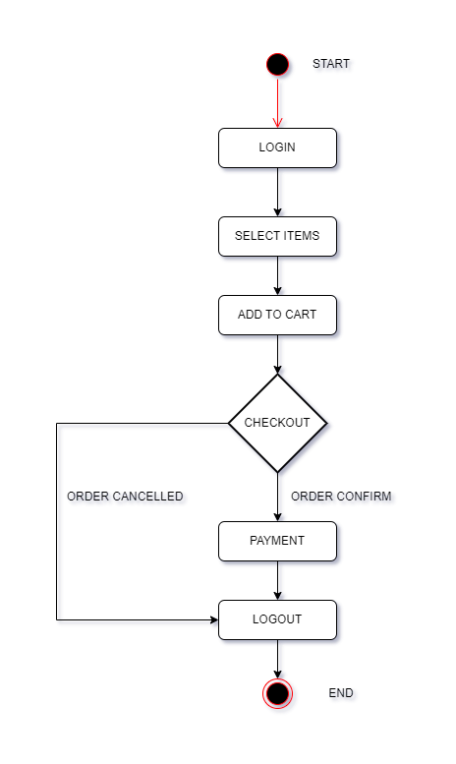
Activity Diagram

Slide 16
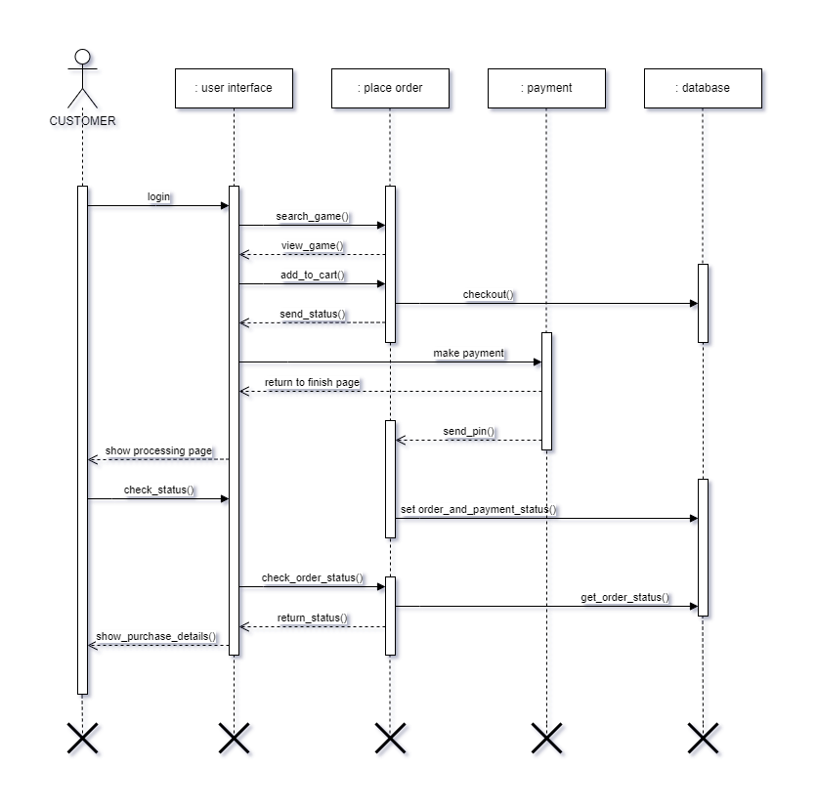
Sequence Diagram

Slide 17
Data Dictionary
ADMIN COLLECTION
FIELD NAME | DATATYPE (SIZE) | CONSTRAINTS | SAMPLE DATA
Admin_id | int (10) | unique | 001
admin_unique_keyid | string (225) | unique | Uqpet14a7e5g6w5w
admin_name | string (225) | - | Administrator
admin_role | string (225) | - | superadmin
admin_email | string (15) | - | kartzed@ecommerce.com
admin_password | string (15) | - | admin@123
admin_image | string (50) | - | Media/Image.png

Slide 18
CUSTOMER COLLECTION
FIELD NAME | DATATYPE (SIZE) | CONSTRAINTS | SAMPLE DATA
cust_id | int (10) | unique | 001
cust_unique_keyid | string (225) | unique | Go910a7e5g6w5w
cust_first_name | string (225) | - | Ram
cust_last_name | string (225) | - | xyz
cust_gender | string (15) | - | male/female
cust_email | string (15) | - | amazon@a.com
cust_phone_number | string (50) | - | 9281634582
is_phone_verified | string (50) | - | True
otp | string (50) | - | 125478
cust_country | string (50) | - | India
cust_state | string (250) | - | Gujarat
cust_city | string (250) | - | Ahmedabad
cust_address | string (250) | - | Jivaraj Park
cust_balance | int (10) | - | 2500

Slide 19
VENDORS COLLECTION
FIELD NAME | DATATYPE (SIZE) | CONSTRAINTS | SAMPLE DATA
vendor_id | INT (10) | UNIQUE | 001
vendor_unique_keyid | STRING (225) | UNIQUE | 001
vendor_fullname | STRING (225) | - | XYZ
vendor_password | STRING (225) | - | XYZ
vendor_email | STRING (15) | UNIQUE | KZed1@a.com
vendor_phone_number | STRING (15) | UNIQUE | 8362547392
company_name | STRING (50) | UNIQUE | Riot Games
company_address | STRING (225) | - | Mumbai, India
company_phone_number | STRING (225) | UNIQUE | 836253491
GSTIN | STRING (225) | UNIQUE | 28362819
pickup_pincode | STRING (225) | - | 380053
pickup_address | STRING (225) | - | Navi mumbai

Slide 20
User Balance Point Collection
FIELD NAME | DATATYPE (SIZE) | CONSTRAINTS | SAMPLE DATA
vendor_id | INT (10) | UNIQUE | 123
vendor_unique_keyid | STRING (225) | UNIQUE | 3400
vendor_fullname | STRING (225) | - | XYZ
Platform Collection
FIELD NAME | DATATYPE (SIZE) | CONSTRAINTS | SAMPLE DATA
platform_id | INT (10) | UNIQUE | 123
platform_name | STRING (100) | UNIQUE | Play Station
Features Collection
FIELD NAME | DATATYPE (SIZE) | CONSTRAINTS | SAMPLE DATA
game_feature_id | INT (10) | UNIQUE | 123
game_feature_name | STRING (100) | UNIQUE | Multiplayer

Slide 21
MODE COLLECTION
FIELD NAME | DATATYPE (SIZE) | CONSTRAINTS | SAMPLE DATA
game_mode_id | INT (10) | UNIQUE | 123
game_mode_name | STRING (100) | UNIQUE | Battle Royale
CATEGORY COLLECTION
FIELD NAME | DATATYPE (SIZE) | CONSTRAINTS | SAMPLE DATA
game_category_id | INT (10) | UNIQUE | 123
game_category_name | STRING (100) | UNIQUE | Adventure
OPERATING SYSTEM COLLECTION
FIELD NAME | DATATYPE (SIZE) | CONSTRAINTS | DESCRIPTION
ID | INT (10) | PRIMARY | 123
BRAND NAME | STRING (15) | UNIQUE | Windows

Slide 22
OPERATING SYSTEM VERSIONS COLLECTION
FIELD NAME | DATATYPE (SIZE) | CONSTRAINTS | SAMPLE DATA
version_id | INT (10) | UNIQUE | 123
os_name | STRING (100) | FOREIGNKEY | Windows
version | STRING (100) | UNIQUE | Window 11
PROCESSOR COLLECTION
FIELD NAME | DATATYPE (SIZE) | CONSTRAINTS | SAMPLE DATA
processor_id | INT (10) | UNIQUE | 123
os_name | STRING (100) | FOREIGNKEY | Windows
processor_name | STRING (100) | UNIQUE | Ryzen 5
VIDEO CARD COLLECTION
FIELD NAME | DATATYPE (SIZE) | CONSTRAINTS | SAMPLE DATA
vc_id | INT (10) | UNIQUE | 123
vc_name | STRING (100) | UNIQUE | Intel, AMD

Slide 23
VIDEO CARD VERSIONS COLLECTION
FIELD NAME | DATATYPE (SIZE) | CONSTRAINTS | SAMPLE DATA
vc_version_id | INT (10) | UNIQUE | 123
vc_name | STRING (100) | FOREIGNKEY | Intel, AMD
vc_version_name | STRING (100) | UNIQUE | GeForce GTX
OFFERS COLLECTION
FIELD NAME | DATATYPE (SIZE) | CONSTRAINTS | SAMPLE DATA
offer_id | INT (10) | UNIQUE | 123
offer_name | STRING (100) | - | 50% off…
offer_description | STRING (100) | - | Offer description
offer_tc | STRING (100) | - | Terms & Conditions
PLAN COLLECTION
FIELD NAME | DATATYPE (SIZE) | CONSTRAINTS | SAMPLE DATA
plan_id | INT (10) | UNIQUE | 123
points | INT (10) | - | 100
amount | INT (10) | - | 125

Slide 24
GAMES COLLECTION
FIELD NAME | DATATYPE (SIZE) | CONSTRAINTS | SAMPLE DATA
gid | INT (10) | UNIQUE | 123
product_key | STRING (15) | UNIQUE | Zuiop14q2er4tyo9
vendor_reference | STRING (20) | FOREIGNKEY | Riot Games
game_logo | IMAGE | - | Media/logo/valorant.jpg
game_name | STRING (255) | - | Valorant
game_description | STRING (255) | - | 5v5 shooter game
game_developer | STRING (255) | - | Riot Games
game_publisher | STRING (255) | - | Riot Games
game_storage | STRING (255) | - | 24GB
game_ram | STRING (255) | - | 8GB
game_languages | JSON | - | English, Hindi
game_release_date | STRING (250) | - | 23/4/2020
game_price | INT (10) | - | 545
avail_stock | INT (10) | - | 50
discount | STRING (250) | - | 5%
game_points | INT (10) | - | 450
game_features | JSON | - | Action
game_modes | JSON | - | Bomb Plant
game_categories | JSON | - | Multiplayer
platform_names | JSON | - | Windows, MacOS
os_names | STRING (250) | - | Window
os_versions | STRING (250) | - | Window 11
processors_names | STRING (250) | - | Ryzen 5
vc_names | STRING (250) | - | AMD
vc_versions | STRING (250) | - | GeForce GTX

Slide 25
GAME IMAGES COLLECTION
FIELD NAME | DATATYPE (SIZE) | CONSTRAINTS | SAMPLE DATA
game | STRING (250) | FOREIGNKEY | valorant
images | IMAGE | - | Media/games/image.png
OFFERS COLLECTION
FIELD NAME | DATATYPE (SIZE) | CONSTRAINTS | SAMPLE DATA
contact_id | INT (10) | INT (10) | 123
contact_name | STRING (250) | - | user
contact_email | STRING (250) | EMAIL | user@gmail.com
contact_message | STRING (250) | - | Very Good UI
CART COLLECTION
FIELD NAME | DATATYPE (SIZE) | CONSTRAINTS | SAMPLE DATA
cart_id | INT (10) | - | 45
cust_id | INT (10) | FOREIGNKEY | 1
is_paid | INT (10) | - | True

Slide 26
CART ITEMS COLLECTION
FIELD NAME | DATATYPE (SIZE) | CONSTRAINTS | SAMPLE DATA
cart | INT (10) | FOREIGNKEY | 45
game | INT (10) | FOREIGNKEY | 15
CONTACT COLLECTION
FIELD NAME | DATATYPE (SIZE) | CONSTRAINTS | SAMPLE DATA
contact_id | INT (10) | UNIQUE | 123
contact_name | STRING (250) | - | user
contact_email | STRING (250) | - | user@gmail.com
contact_message | INT (10) | - | Fast Delivery
CONTACT COLLECTION
FIELD NAME | DATATYPE (SIZE) | CONSTRAINTS | SAMPLE DATA
order_id | INT (10) | UNIQUE | 123
order_placed_status | STRING (12) | - | Placed/pending
shipped_status | STRING (7) | - | Shipped/pending
delivered_status | STRING (9) | - | Delivered/pending

Slide 27
Coding Standards
Naming conventions:
Use descriptive and meaningful names for variables, functions, classes, and files.
Use Snake Case for class names and Snake Case for function and variable names.
Use all lowercase letters for file names.
Code formatting:
Use 4 spaces for indentation.
Limit lines to a maximum of 80 characters.
Use single quotes for string literals unless a single quote appears within the string.
Error handling:
Use try-except blocks to handle exceptions.
Database design:
Use MongoDB's schema less design to store game data.
Use appropriate data types for fields.
Use indexes to improve query performance.
Testing:
Write unit tests for few functions and class.
Documentation:
Use clear and descriptive comments for each function and class.
Use Draw.io, quill Bot or similar tools to generate documentation.

Slide 28
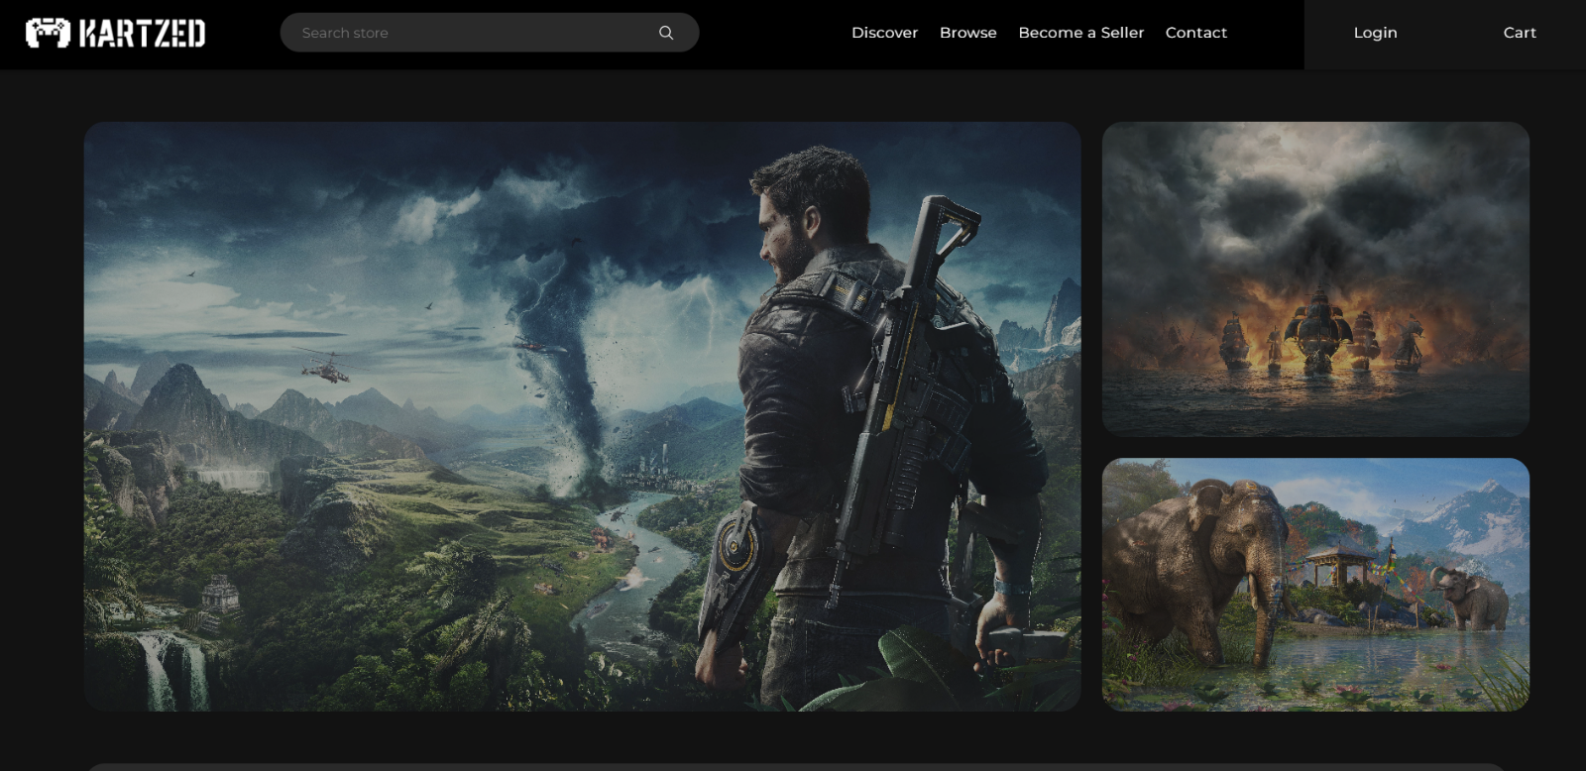
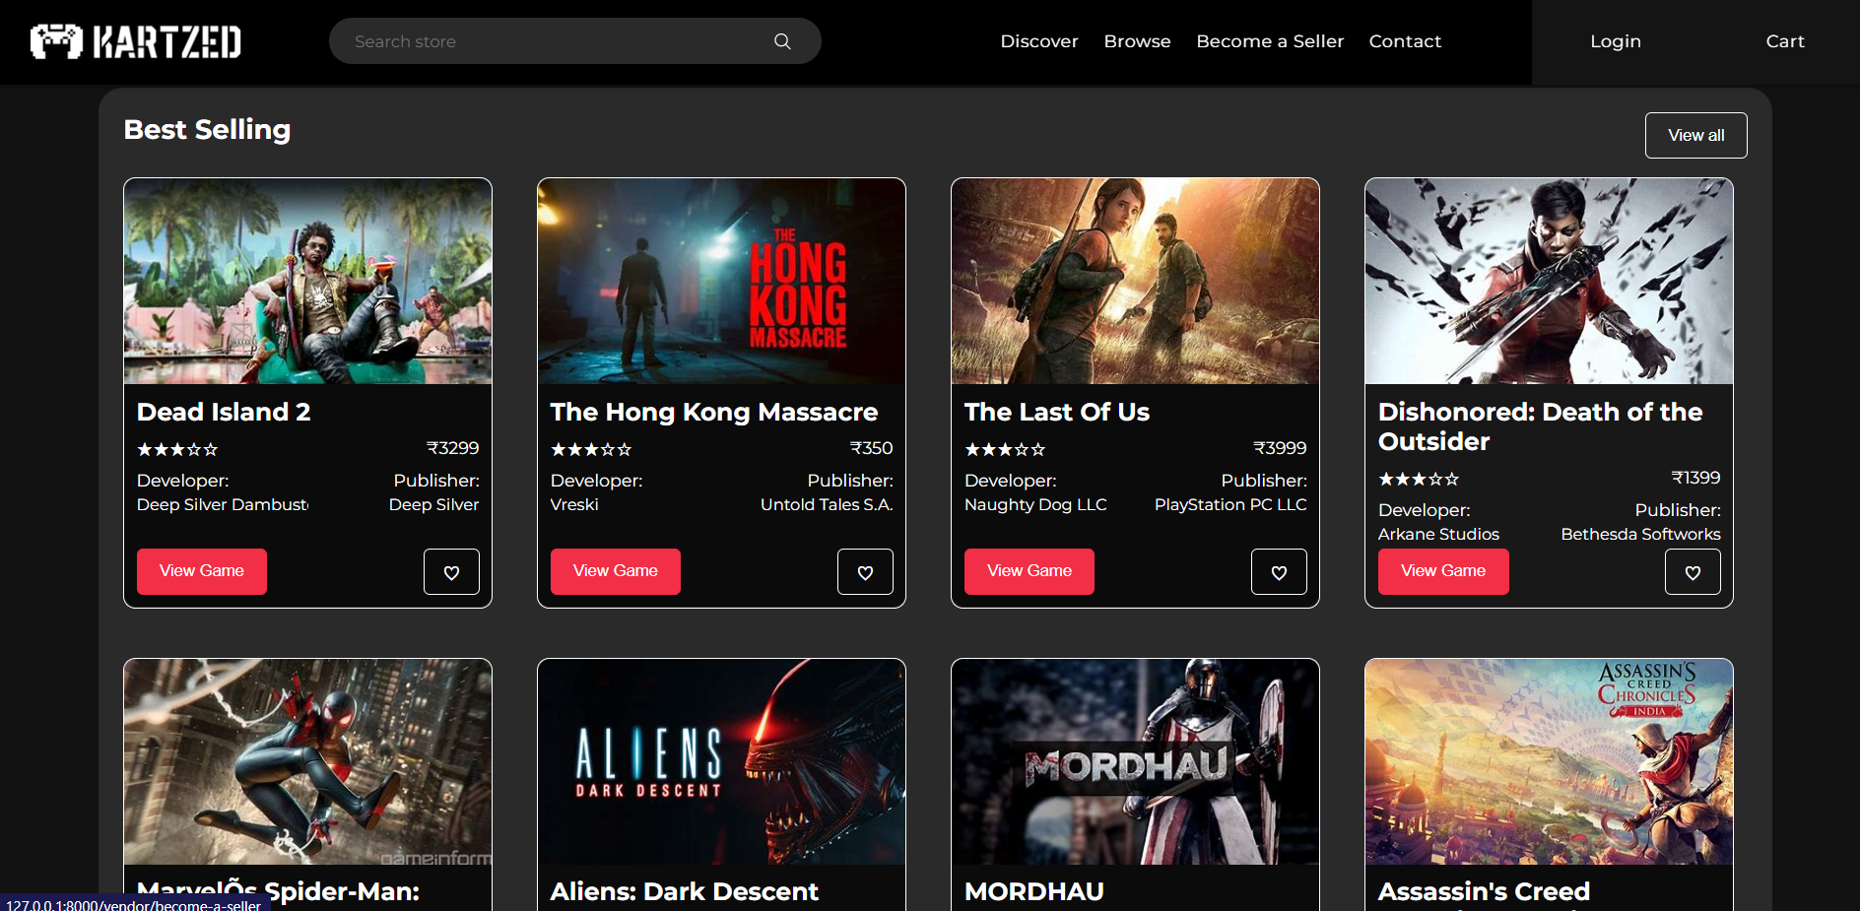
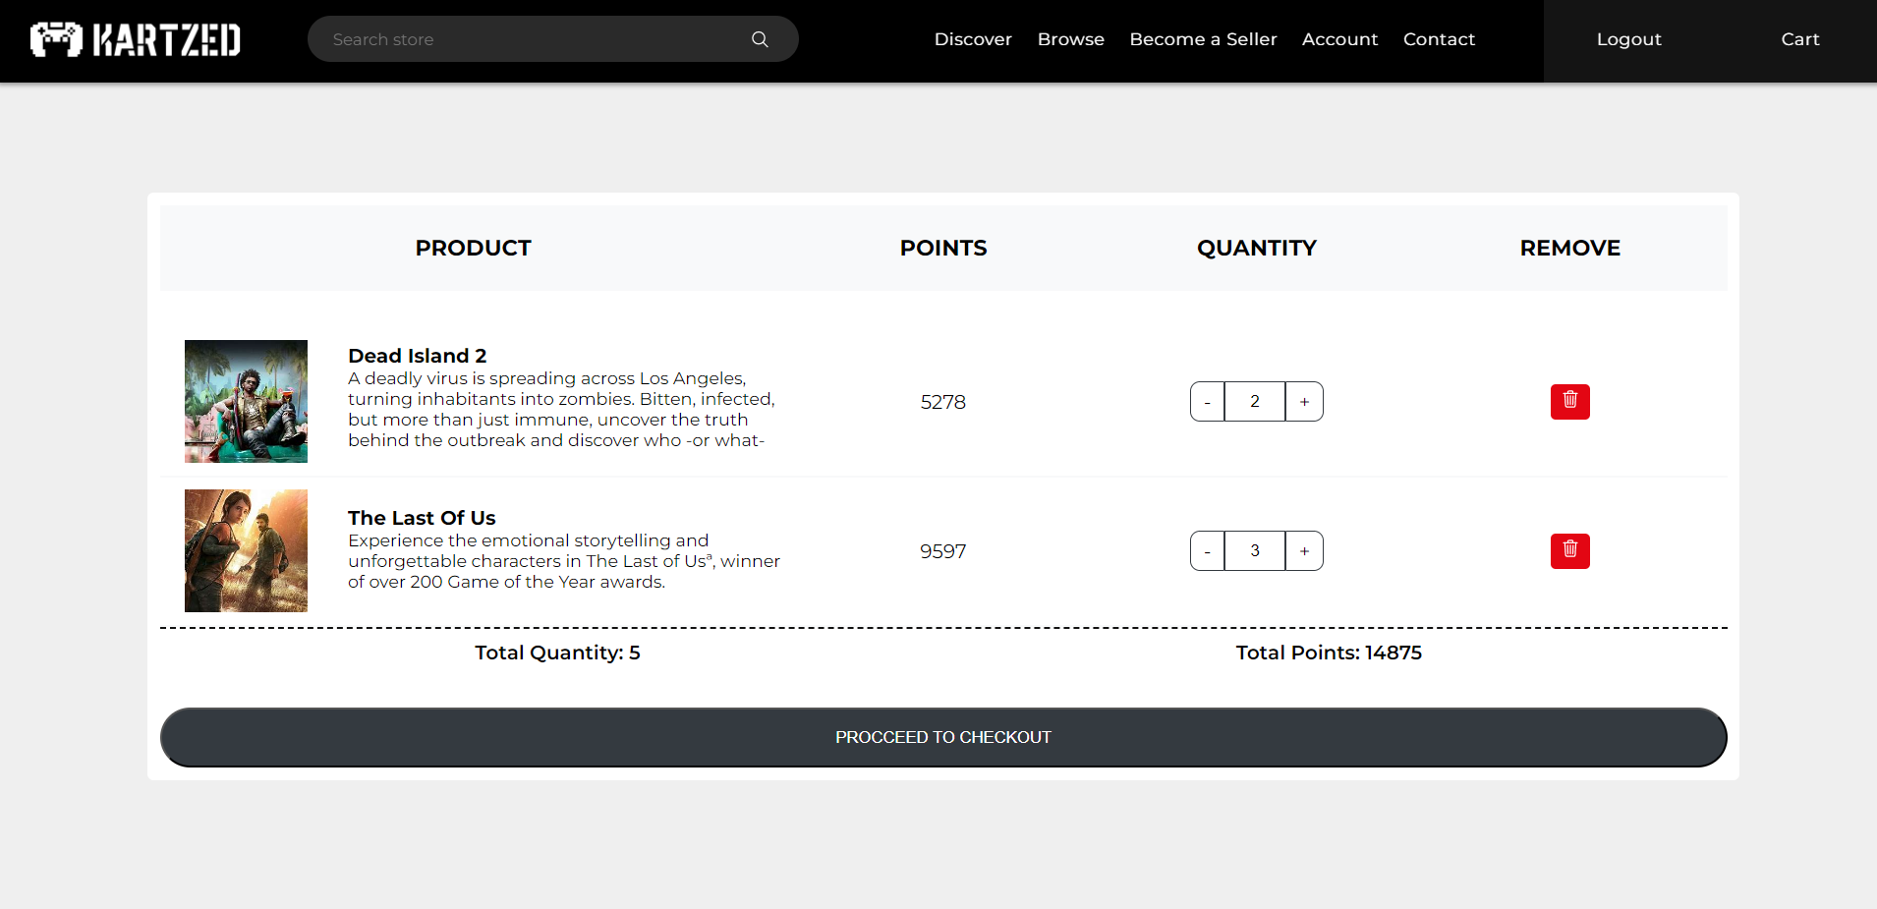
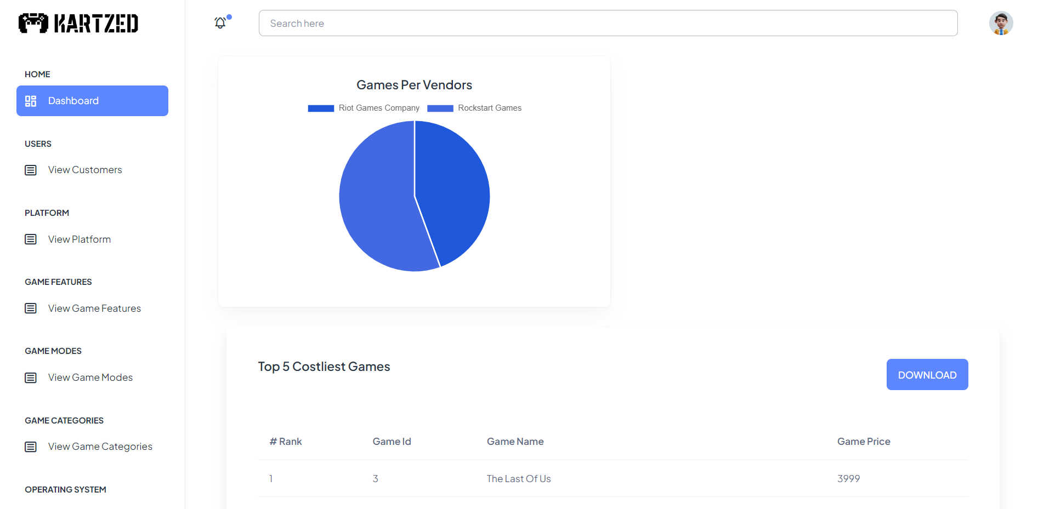
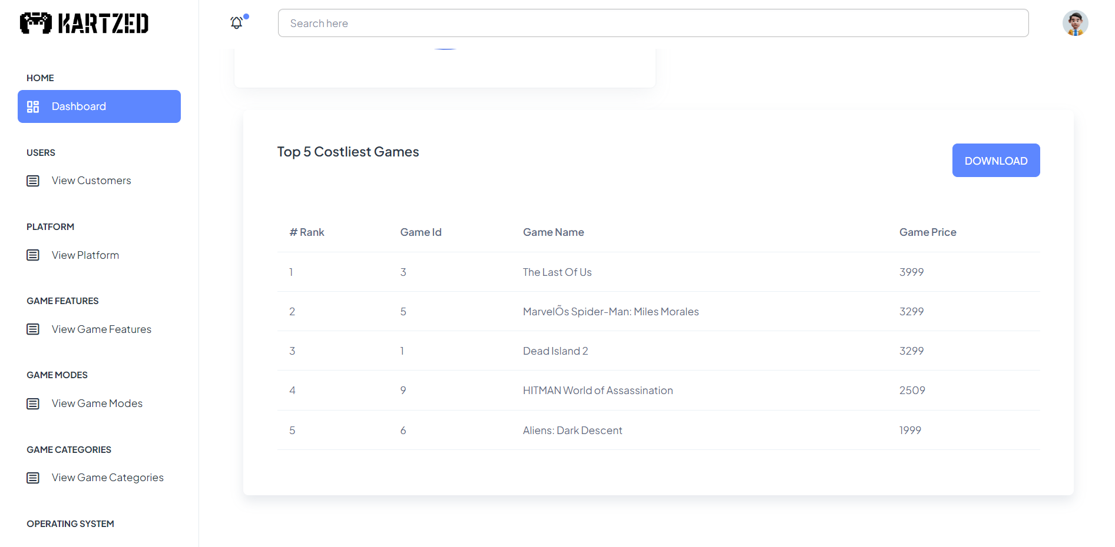
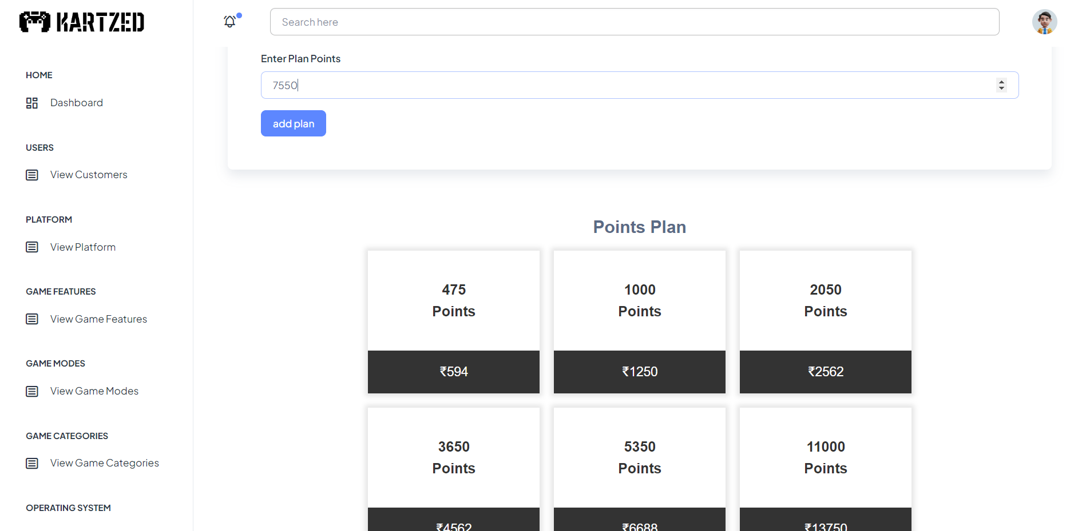
Screenshots
Please refer to the documentation for additional pictures

Slide 29
Agile Project Charter
MSSION | One stop solution Simple navigation Quick product display Increase in availability Ease user task by 60-70%
VISION | Provide all required to customers what they needed all over nation
SCOPE | The scope of the project includes the entire gaming community up to all boundaries. Its expandable to new games creation and launch.

Slide 30
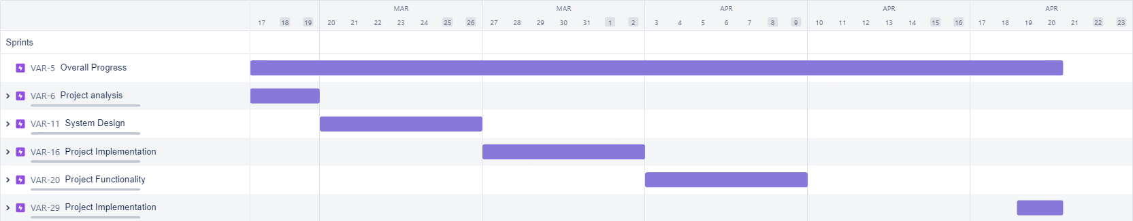
Roadmap/Schedule

Slide 31
Agile Project Plan
Sr No. | Date | Module | Author | Status
1 | 26/03/2023 | Basic Project Created | Vasu | Done
2 | 26/03/2023 | Admin: Login | Vasu | Done
3 | 26/03/2023 | Vendor: Register | Vasu | Done
4 | 26/03/2023 | Vendor: Login | Vasu | Done
5 | 26/03/2023 | Customer: Login | Vasu | Done
6 | 26/03/2023 | Email Verification | Vasu | Done
7 | 28/03/2023 | Admin: Change Password | Vasu | Done
8 | 28/03/2023 | Admin: Forgot Password | Vasu | Done
9 | 29/03/2023 | Admin: Logout | Vasu | Done
10 | 29/03/2023 | Vendor: Logout | Vasu | Done
11 | 29/03/2023 | Customer: Logout | Vasu | Done
12 | 01/04/2023 | Admin: Dashboard | Vasu | Done
13 | 01/04/2023 | Admin: Dashboard - View Reports | Bhavin | Done
14 | 01/04/2023 | Admin: View Customers | Bhavin | Done
15 | 03-04-2023 | Admin: Dashboard - Download PDF | Vasu | Done
16 | 04/04/2023 | Admin: Platform (CRUD) | Bhavin | Done
17 | 04/04/2023 | Admin: Game Features (CRUD) | Bhavin | Done
18 | 04/04/2023 | Admin: Game Modes (CRUD) | Bhavin | Done
19 | 05/04/2023 | Admin: Game Categories (CRUD) | Bhavin | Done
20 | 05/04/2023 | Admin: Operating System (CRUD) | Vasu | Done
21 | 07/04/2023 | Admin: Processor (CRUD) | Bhavin | Done
22 | 07/04/2023 | Admin: Video Card (CRUD) | Bhavin | Done
23 | 10/04/2023 | Admin: Offers (CRUD) | Bhavin | Done

Slide 32
Continue…
24 | 11/04/2023 | Admin: Balance Points Plan (CRUD) | Bhavin | Done
25 | 12/04/2023 | Admin: View Contacts (CRUD) | Varad | Done
26 | 13/04/2023 | Vendor: Add Games - Form | Vasu | Done
27 | 15/04/2023 | Vendor: Add Games - CSV/Excel Upload | Vasu | Done
28 | 15/04/2023 | Vendor: View Uploaded Games | Vasu | Done
29 | 16/04/2023 | Vendor: Download Uploaded Games (csv/excel) | Vasu | Done
30 | 16/04/2023 | Vendor: Bulk Image Upload (Games) | Vasu | Done
31 | 17/04/2023 | Vendor: Delete Games | Vasu | Done
32 | 17/04/2023 | Vendor: Contact Admin | Varad | Done
33 | 18/04/2023 | Vendor: Dashboard - View Reports | Varad | Done
34 | 18/04/2023 | Customer: Homepage | Vasu | Done
35 | 19/04/2023 | Customer: Browse Games | Varad | Done
36 | 19/04/2023 | Customer: Search Games | Varad | Done
37 | 20/04/2023 | Customer: Filter Games | Varad | Done
38 | 21/04/2023 | Customer: Product Page | Varad | Done
39 | 21/04/2023 | Customer: View Profile | Varad | Done
40 | 22/04/2023 | Customer: Update Profile | Vasu | Done
41 | 24/04/2023 | Customer: Buy Balance Points | Bhavin | Done
42 | 26/04/2023 | Customer: Add to Cart | Bhavin | Done
43 | 28/04/2023 | Customer: View Cart | Bhavin | Done
44 | 01/05/2023 | Customer: Checkout | Bhavin | Done
45 | 01/05/2023 | Customer: Contact Admin Customer | Varad | Done
46 | 02/05/2023 | Track Purchase Order | Varad | Not Done

Slide 33
Agile User Story
User | Action | Value
As a User | I want to register | So that I register
As a User | I want to login | So that I logged in
As a User | I want to select game | So, I select a game
As a User | I want to add to cart a game | So, I added game to my cart
As a User | I want to buy a game | So, I got to purchase page
As a User | I want to purchase a game | So, I purchased a game
As a User | I want to search game | So, I enter input in search bar
As a User | I want to filter game | So, I select filter
As a Vendor | I want to add product | So, I fill the form
As a Vendor | I want to view product | So, Click on view product
As a Vendor | I want to Contact admin | So, I fill the contact form
As an admin | I want to logged in | So, I fill the form
As an admin | I want to add platform | So, I fill the form
As an admin | I want to add features | So, I fill the form
As an admin | I want to add modes | So, I fill the form
As an admin | I want to add categories | So, I fill the form
As an admin | I want to add OS Versions | So, I fill the form
As an admin | I want to add processors | So, I fill the form
As an admin | I want to add Video Cards | So, I fill the form
As an admin | I want to add offers | So, I fill the form
As an admin | I want to contact | So, I fill the form

Slide 34
Agile Release Plan
TASK NAME | DURATION | START | FINISH | STATUS | RELEASE DATE
Admin Side/Vendor Side/Customer Side: -Login/Registration -Logout | 3 days | 17/03/2023 | 19/03/2023 | complete | 20/03/2023
Admin Side: -Platform CRUD -Game Features CRUD -Game Modes CRUD -Game Categories CRUD | 7 days | 20/03/2023 | 26/03/2023 | complete | 27/03/2023
Admin Side: -OS & Versions CRUD -Processors CRUD -VC & Versions CRUD -Offer CRUD | 7 days | 27/03/2023 | 02/04/2023 | complete | 03/04/2023

Slide 35
Continue…
Admin Side: -Plan CRUD Vendor Side: -Game CRUD | 7 days | 03/04/2023 | 09/04/2023 | complete | 10/04/2023
Vendor Side: -Contact CRUD Customer Side: -Index Page -Browse Page -View Game Details | 7 days | 10/04/2023 | 16/04/2023 | complete | 17/04/2023
Customer Side: -Profile Page -Contact Page -Search Module | 7 days | 19/04/2023 | 23/04/2023 | Complete | 24/04/2023
Customer Side: -Buy Points Admin Side: -Reports Vendor Side -Reports | 7 days | 24/04/2023 | 30/04/2023 | Complete | 01/04/2023

Slide 36
Agile Sprint Backlog
Task Name | Duration | Story | Sprint ready | Priority High | Story Point | Status
User Side
Login | 1D | Yes | Yes | High | 10 | Complete
Dashboard | 2D | Yes | Yes | High | 10 | Complete
Show product | 1D | Yes | Yes | Low | 5 | Complete
Vendor Side
Dashboard | 1D | No | Yes | High | 10 | Complete
Add product | 2D | Yes | Yes | High | 10 | Complete
View product | 2D | Yes | Yes | Medium | 7 | Complete
Admin Side
Dashboard | 1D | No | Yes | High | 10 | Complete
Platform | 1D | Yes | Yes | Medium | 6 | Complete
Feature | 2D | Yes | Yes | Medium | 6 | Complete
Type | 1D | Yes | Yes | Medium | 6 | Complete
Operating System | 2D | Yes | Yes | Medium | 6 | Complete
Processor | 1D | Yes | Yes | Medium | 6 | Complete
Video Card | 2D | Yes | Yes | Medium | 6 | Complete
RAM | 1D | Yes | Yes | Medium | 6 | Complete
Offers | 2D | Yes | Yes | Low | 3 | Complete
Contact | 1D | Yes | Yes | Low | 3 | Complete
Languages | 2D | No | Yes | Medium | 2 | Complete
Cart | 4D | No | Yes | High | 3 | Complete
Purchase | 3D | No | Yes | High | 4 | Complete

Slide 37
Agile Test plan
Project Name: KartZed Test Case Id: 1
Module Name: Login module Test Title: Login user
Device/Browser: Lenovo Y540 Execution Date: 20/04/2023
No | Test step | Action | Expected Result | Actual Result | Status
1 | Navigating Login page | Add URL in browser | Redirect Login Page | Redirect Login Page | Pass
2 | Enter login mail | Send mail to user | User get OTP in mail | User get OTP in mail | Pass
3 | Verify Email | Match user OTP with send OTP | Verify the user OTP | Verify the user OTP | Pass
4 | Enter Details | Send email detail to server | Email recorded in server | Email recorded in server | Pass

Slide 38
Project Name: KartZed Test Case Id: 2
Module Name: Add Product Test Title: Add Game from vendor
Device/Browser: Lenovo Y540 Execution Date: 24/04/2023
No | Test step | Action | Expected Result | Actual Result | Status
1 | Navigating add game page | Add URL in browser | Redirect add game Page | Redirect add game Page | Pass
2 | Enter form details | Send details to server | Details sent to database | Details sent to database | Pass
3 | Detail recorded | Details recorded in database | Recorded in database | Recorded in database | Pass

Slide 39
Project Name: KartZed Test Case Id: 3
Module Name: Confirm checkout Test Title: Login user
Device/Browser: Lenovo Y540 Execution Date: 24/04/2023
No | Test step | Action | Expected Result | Actual Result | Status
1 | Navigating Index page | Add URL in browser | Redirect Index Page | Redirect Index Page | Pass
2 | Select Game | Click Add to Cart | Game get Add to Cart | Game get Add to Cart | Pass
3 | Detail Recorded | Details recorded in database | Recorded in database | Recorded in database | Pass
4 | Navigating Cart Page | Add URL in browser | Redirect Cart Page | Redirect Cart Page | Pass
5 | View Cart Page | Check Cart | Confirm Cart to Checkout | Confirm Cart to Checkout | Pass

Slide 40
Earned Value & Burn Chart

Slide 41
Future Work
Enhance Customer Support
Improve customer service and provide prompt responses to customer inquiries by using chatbots, automatic email responders, and other tools.
Augmented Reality
Allow shoppers to digitally try on clothing or see how furniture might appear in their house with augmented reality.

Slide 42
Developed By
Kalal Bhavin
Joshi Varad
Sidapara Vasu
Enrolment no.: 2020004500210021
Semester: 6 ​
Enrolment no.: 2020004500210019
Semester: 6
Enrolment no.: 2020004500210067
Semester: 6

Slide 43

GitHub URL
https://github.com/SidaparaVasu/KartZed_Django

Slide 44

Thank you
bhavinkalal3118@gmail.com
varadjoshi13@gmail.com
vasupatel303@gmail.com

